Slide 1






P
Government Support for sustainable food policies
Daiary industry lobbying leads to stricter regulations on planet-based labeling
Politics
ANALYSIS OF OATLY’S MARKET INFLUENCES
E
Plant-based milk industry is growing rapidly
Premium pricing limits affordability
Inflation impacts raw material costs(oats, packaging
Economy
S
Strong consumer shift towards eco-friendly and ethical consumption
Younger generations drive demand for sustainable plant-based alternatives
Society
T
Innovations in food processing & production efficiency reduce costs
AI and automation in supply chain logistics enhance distribution
Technology
PESTEL
E
Oatly’s commitment to lowering carbon footprint aligns with global sustainability goals
Climate change risks may impact oat crop yields and sourcing
Environment
L
Stricter food labeling laws may limit marketing strategies
Compliance with food safety regulations across different markets
Law

Slide 2


INDUSTRY ATTRACTIVENESS: OATLY & THE PLANT-BASED MILK MARKET
Key Demand Drivers
H: Health Consciousness (lactose intolerance, cholesterol concerns)
V&S: Veganism & Sustainability trends
PBD: Growing preference for plant-based diets
H
V & S
PBD
Barriers to Entry
High brand loyalty (Oatly, Alpro, Califia Farms dominate)
Supply chain complexity (sourcing high-quality oats, production scale)
Regulatory constraints (labeling restrictions, dairy industry lobbying)
Market Growth and Profitability
Market Growth: The oat milk industry is projected to reach $5.37 billion by 2029, with a CAGR of 13.69%.
Profitability: Revenue for Oatly increased by 9.6% in Q3 2024, showing strong market demand.

Slide 3
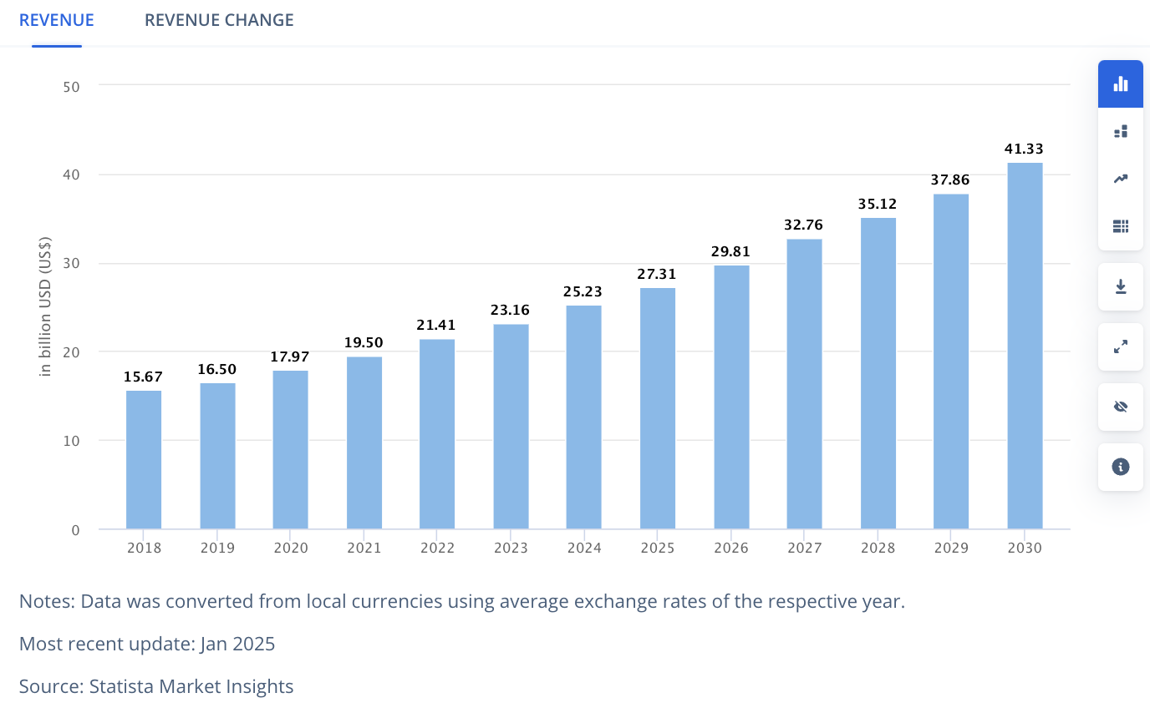
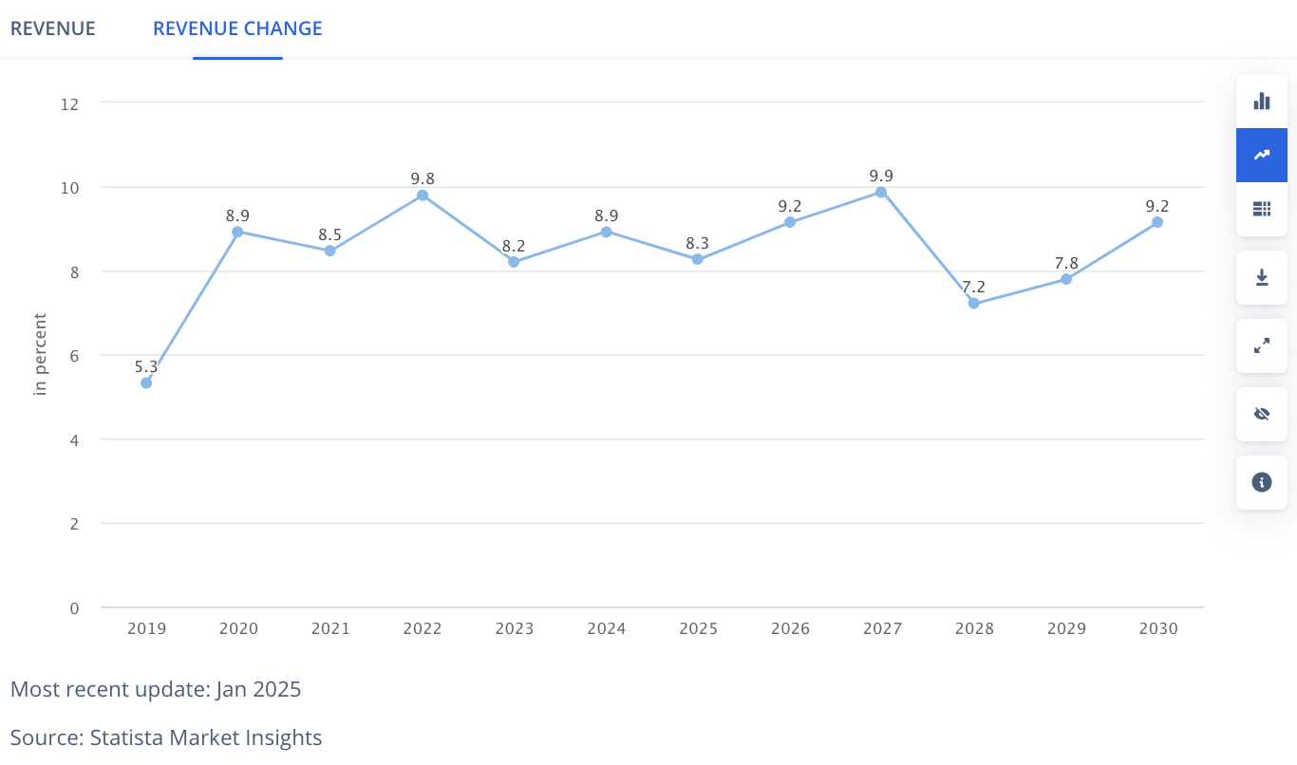
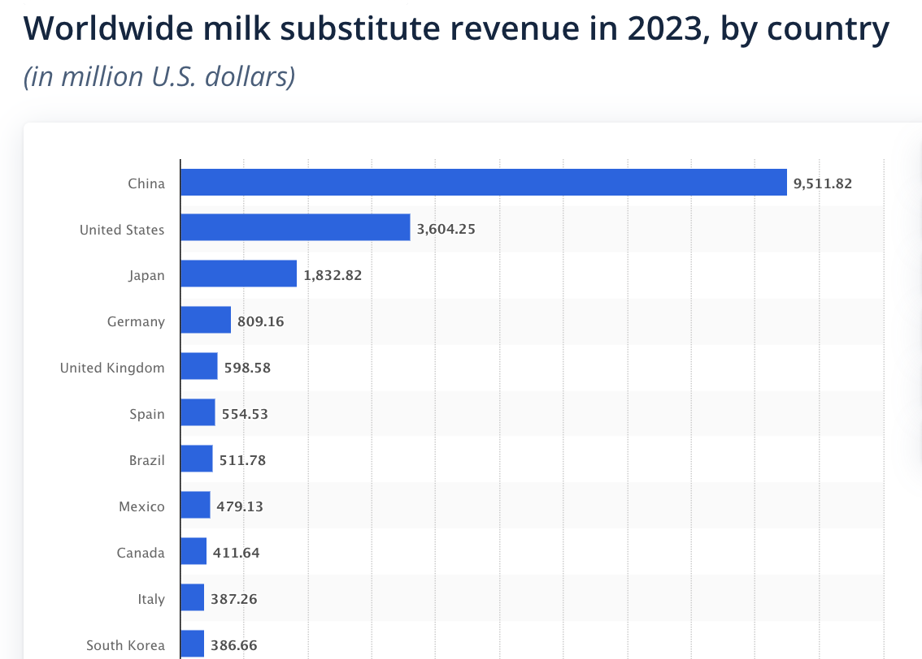
Global and Regional Milk Substitutes Market Analysis
Global Trend
Globally, the milk substitute market is steadily growing, driven by rising demand for plant-based and dairy-free alternatives. Sustained high growth rates indicate the market is far from saturation, offering opportunities for investment and innovation. Expansion potential is particularly strong in emerging markets where plant-based diets are on the rise. Companies should focus on innovation and geographical expansion to seize these opportunities.
Regional Difference
Emerging markets (e.g., Brazil) are growing rapidly, with consumer demand focused on health and affordable products.
Developed markets (e.g., North America, Europe) are maturing, with functional and premium products being the main drivers.
The Chinese market faces challenges, but innovative categories like coconut milk and functional soy milk offer some growth opportunities.

Slide 4
Porter‘s Five Forces
Bargaining Power of Suppliers
Bargaining Power of Buyers
Threat of Substitutes
Industry Rivalry
Threat of New Entrants
Supplier bargaining power is moderate, driven by technology dependency and premium raw material demand, but alleviated by global supply chain management.
Buyer bargaining power is high, especially in markets with abundant substitutes or price-sensitive consumers.
The threat of substitutes is high, especially in the globally diversified plant-based dairy market.
Industry rivalry is very intense, especially in mature markets and rapidly growing emerging markets.
The threat of new entrants is moderate, particularly more pronounced in emerging markets.
The plant-based dairy market has numerous substitutes, including soy milk, almond milk, and coconut milk, which perform differently across regions. For example, oat milk demand is high in North America and Europe, but almond milk remains a major competitor; in emerging markets like Brazil and Southeast Asia, soy milk and coconut milk are more popular. Additionally, traditional dairy (e.g., cow’s milk) remains a threat in terms of price and nutritional value, especially in price-sensitive markets. Changes in consumer preferences for taste, nutrition, and sustainability may further increase the appeal of substitutes.
The plant-based dairy industry is highly competitive, with numerous strong players globally, including international brands (e.g., Alpro, innocent，Silk) and local brands (e.g., local soy milk brands in Brazil, Coconut Palm Group in China). In North America and Europe, markets are maturing, and competition focuses on product innovation (e.g., functional beverages) and brand marketing; in emerging markets, price competition is more intense. Oatly, with its strong brand recognition and sustainability positioning, holds a significant place in the global market but must continuously innovate to counter challenges from competitors.
The plant-based dairy industry has relatively low entry barriers, especially in emerging markets, where many local brands and startups are entering. However, Oatly’s brand strength, proprietary technology (e.g., oat enzymatic processing), and sustainability positioning provide it with a competitive moat. In mature markets like North America and Europe, new entrants face higher barriers due to the need for significant brand and distribution investments. In emerging markets like Brazil and Southeast Asia, price competition and localized strategies make the threat of new entrants more pronounced.
Consumers in the global plant-based dairy market have significant bargaining power due to the wide variety of alternatives (e.g., soy milk, almond milk, coconut milk). In mature markets like North America and Europe, demand for functional and premium products (e.g., high-protein, low-sugar) provides Oatly with some pricing power. However, in price-sensitive emerging markets (e.g., Brazil and Southeast Asia), Oatly’s premium positioning may limit its appeal. Additionally, retailers and distribution channels (e.g., supermarkets, e-commerce platforms) hold strong bargaining power globally, further squeezing brand profit margins.
Oatly’s primary ingredient is oats, and while global oat supply is relatively stable, the growing demand for plant-based dairy may put pressure on premium oat supply. Oatly’s reliance on proprietary processing technology (e.g., enzymatic technology) also increases dependency on specific suppliers and equipment providers. However, since oats are a widely cultivated crop, supplier bargaining power remains generally low. Additionally, Oatly’s global production facilities (e.g., in Europe and North America) help mitigate supply chain risks.

